Slide 1
PubHub Requirements
Functional, Usability, System, Security

Slide 2
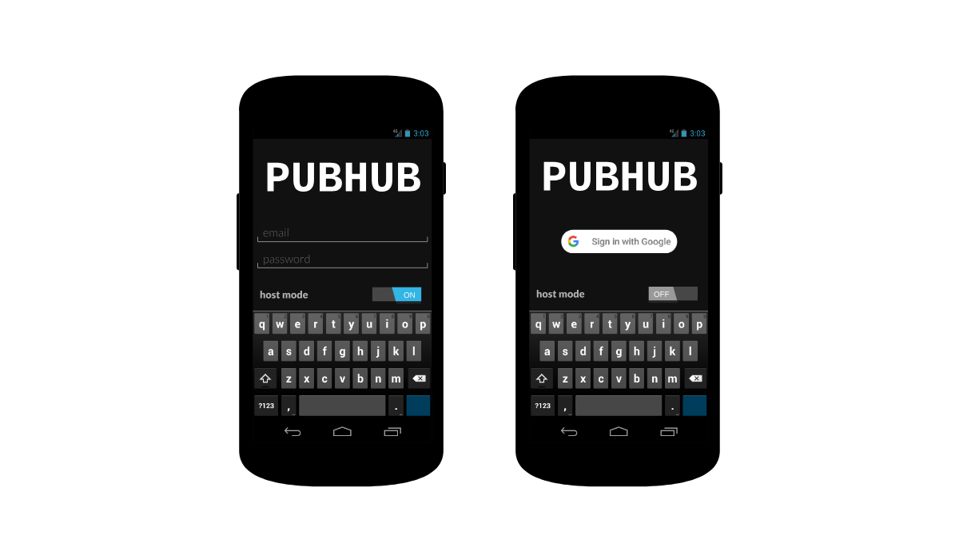
User story: The user can log in to their account.

Slide 3
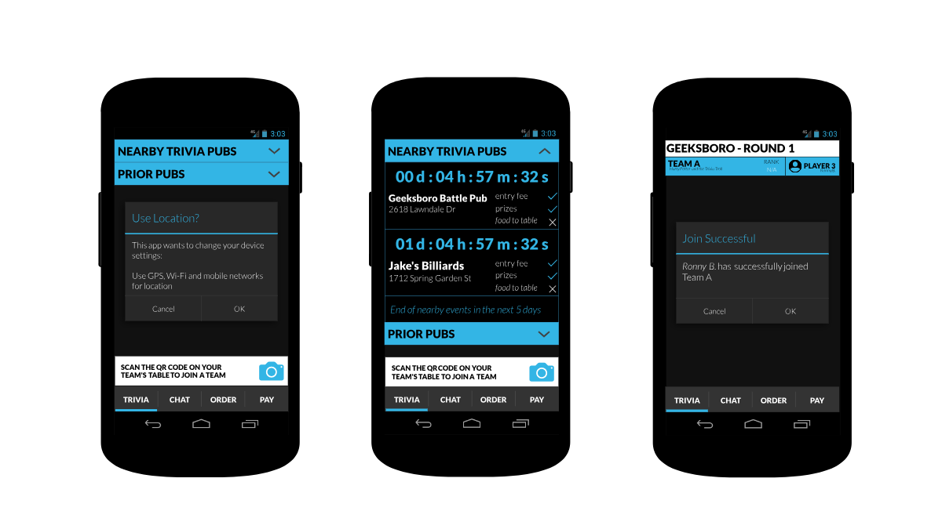

User story: Customers can scan a QR code to join a table/team.

Slide 4
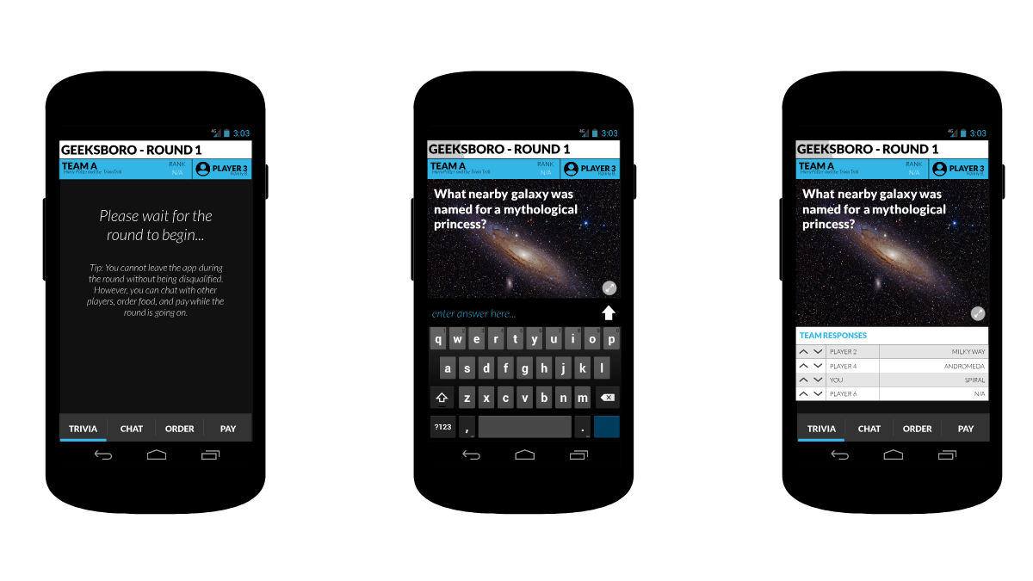
User story: Customers can view trivia questions. User story: Customers can submit answers to questions.
Notes:
@@Q Vote at end of round or

Slide 5
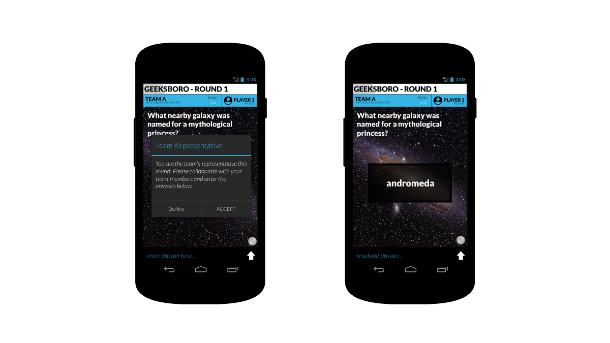
User story: Customers can view trivia questions. User story: Customers can submit answers to questions.
Notes:
@@TODO Crop PDF for higher res if time permits

Slide 6
System
Hardware
Database server
Web server to run backend application
Software
Android application for users
Backend server application
Web interface for presenter view
Database
NoSQL database
Tables store user data, trivia data, chat data
Notes:
DB: expand on scale, fields, data size, etc

Slide 7
Security
Role based permissions:
Admin: Sets user roles, and has access to chat.
Employee: Access to future features (chat moderation, order processing), and chat.
Host: Can create trivia, host trivia, and access chat.
Customer: Access to chat and to trivia. (Default role)
HTTPS for communication between server and the App
Store credentials (API access tokens, DB credentials, etc.) in environment variables.
Securely manage user token
No private or sensitive information stored so encryption should not be needed.

Slide 8
PubHub Specifications

Slide 9
Focus / Domain / Area
Focus
Streamline the process of creating, playing, and grading pub trivia
Chat functionality
Domain
Mobile application
Web application
Genre
Trivia Game

Slide 10

Frameworks and Language
Backend in Node.js 8 (the ocho)
Android Application built with Flutter and Dart
Web in HTML/CSS/Javascript

Slide 11
Development Environment
Visual Studio Code
Android Studio
Android Marshmallow 6.0
DynamoDB
Amazon Web Service (AWS) Elastic Beanstalk

Slide 12

Questions

